Slide 1
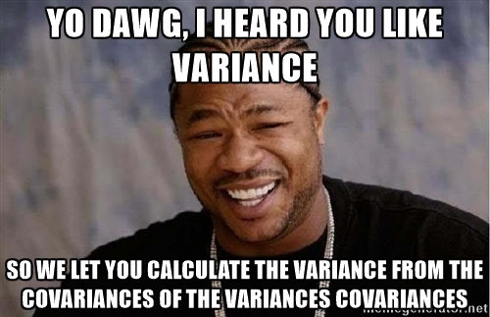
PP 297 – 001: Stata for Policy Analysts
Welcome!
Feel free to come up and ask questions on anything!
Otherwise, open Stata and download the do-files and data for the session
Take your nametag from the stack going around
Notes:
12:00 – 12:10

Slide 2
Office Hours
Tuesdays and Thursdays 9 – 10 am in GSPP Computer Lab
Happy to provide:
Stata help on our problem sets
Stata help on PP 240B problem sets
Empirical research questions (IPA’s included!)
Data science help (including other programs)
Refutation of the underlying assumptions of neoclassical economics
Notes:
12:10

Slide 3
Feedback on Problem Set 3
Comments on Format / Structure?
Questions on Themes / Tests / Steps?
Suggestions for Problem Set 4?
Notes:
12:10 – 12:12

Slide 4
Problem Set 4
Current Plan:
Use any dataset (30min)
Process Data as Needed (30min)
Bonus for using Reshape, Merge, or Append
Data exploration made easy (30min)
Summary Stat Tables using estpost
Histograms or Distribution Plots with loops
Bonus for using Loop to export plots and check heteroskedasticity (today’s topic)
Construct Multivariate Regression Model in Stages (40min)
Create Bivariate Reduced Model
Add Controls (Bonus with Macros!)
Decide on “Best” Model (ex. In S8 Do-File)
Test for Clustered Errors & Robustness (today) (30min)
Add clustered errors or robust std. errors
Iteratively remove variables and check robustness of coefficients
Interpret Outcome of Regression Model(s) with estout (15min)
Notes:
12:12 – 12:15

Slide 5
Today’s Roadmap
Review Reshape, Macros, and Loops
Preserve/Restore
Collapsing Data for Stats and Aggregation
Clustered Errors by Group / Level
Testing and Correcting Heteroskedasticity
Overview of Robustness Checks
Notes:
12:15

Slide 6
Preserve/Restore
For the indecisive Stata user
Notes:
12:15

Slide 7
Preserve/Restore
You can create “preserve points” in Stata, where your dataset will save in memory and any data manipulation after that point will not affect that memory
preserve
…
…
restore
Notes:
12:15 – 12:18

Slide 8
Preserve/Restore
Example:
preserve
drop if age < 18
tab age
restore
Note: You have to run all commands in a single “do”
It’s like a local macro – if you run them separately it won’t work
Notes:
12:18 – 12:20

Slide 9
Collapsing
What happens to me after a full day of grad school
Notes:
12:20

Slide 10
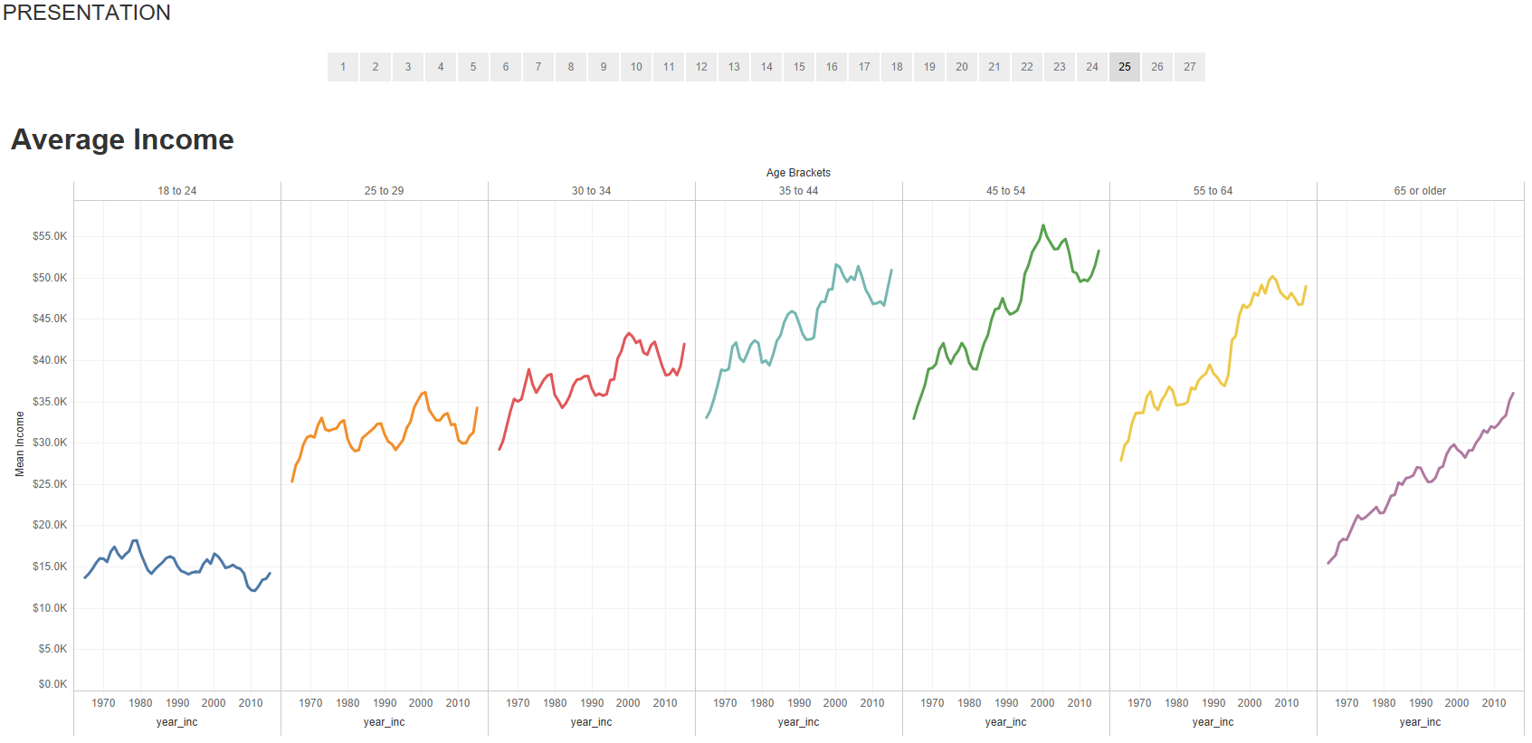
collapse
Log Files
Stored Statistics
Notes:
12:21

Slide 11
Collapsing
Probably one of the most useful commands in Stata!
collapse (stat) [target_var] = [varname] … , by([group(s)])
varname: existing variable
target_var: the name for your newly collapsed variable
I included the ellipses because you can add as many statistical functions to a collapse as you’d like (the full list is given in the help file)
The output will include variables for each statistic that you are testing and a number of rows for each group combination
Notes:
12:21 – 12:24

Slide 12
Collapsing
With our survey datasets, you can add a weight at the end of collapse (before the options)
Ex.: keep if year == 2016
collapse (median) inctot = median_inc /// [pw=wtsupp], by(age_bracket year_inc)
Note: use year_inc for income variables (income reported in previous year)
Notes:
12:24 – 12:26

Slide 13
Collapsing
You can collapse a large list of summary statistics across different variables, by a group (like year)
Then you can export that dataset as a .csv to have an easily sharable table of relevant summary stats
This may be faster than looping tabstat or summ
You can also use estpost to make summary stat tables, but collapse can be more flexible
Notes:
12:26 – 12:28

Slide 14
Collapsing
Perhaps most importantly, you can use collapse to aggregate data to a higher “grouping” level
In the PSID data we’ve aggregated to the family level
But this can easily cause bias problems depending on how you combine data, so proceed with extreme caution
We collapse in a slapdash fashion for educational purposes, normally I would take several days to ensure the aggregation didn’t bias anything and recalculate all the errors
Stata has survey specific commands for this type of thing (svy)
Notes:
12:28 – 12:30

Slide 15
Clustering Errors
Because errors can get lonely too…
Notes:
12:30

Slide 16
Why Cluster Errors?
One of the fundamental assumptions of OLS regression is the independence of errors
But if we have families of related observations, are they truly independent?
Income, education, health, etc. may all be correlated
What about students within schools?
Test results may be correlated between students within the same school due to teacher quality, funding, etc.
Notes:
12:30 – 12:32

Slide 17
Correcting for Clustered Errors
If we suspect our observations may be related in known clusters we can add an option to our regression: vce(cluster cluster_var)
VCE stands for the variance-covariance estimator
Comparing the original regression model to the cluster specified model can help us decide if there was truly a cluster effect
Notes:
12:32 – 12:40

Slide 18
Testing and Correcting for Heteroskedasticity
The most pretentious way to say “changing levels of variance”
Another example of academics justifying their funding with big words
Notes:
12:40

Slide 19
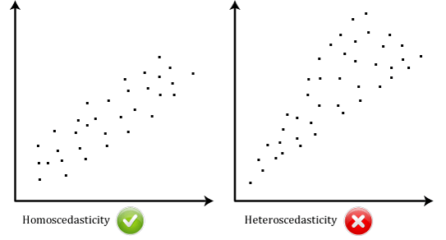
What is heteroskedasticity?
Notes:
12:40

Slide 20
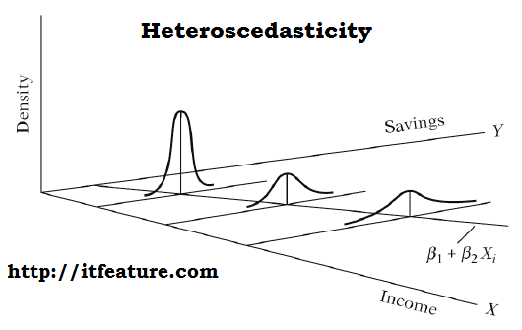
Notes:
12:42

Slide 21
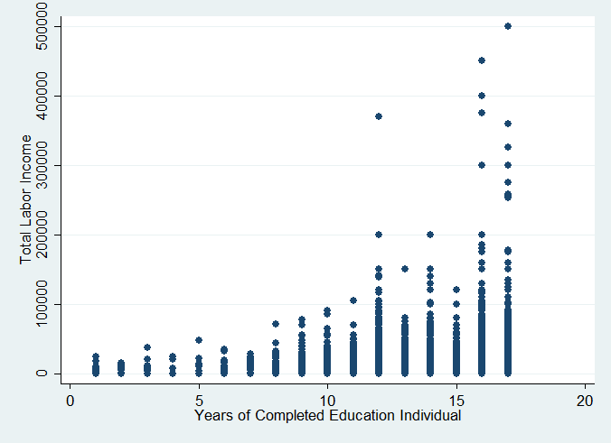
Notes:
12:44

Slide 22
Testing for Heteroskedasticity
After running a regression, you can test for heteroskedasticity in two ways:
Plotting the residuals against the fitted values
rvfplot
Statistical tests attributed to Breusch-Pagan (1979) and Cook-Weisberg (1983), the most general of which is White’s Heteroskedasticity Test
imtest, white
High chi-squared values == low p-value == heteroskedastic
Notes:
12:45 – 12:50

Slide 23
Correcting for Heteroskedasticity
Some people suggest just throwing , robust after a regression model
This can help slightly but doesn’t fully account for a poorly specified model
Linear regressions don’t account for logarithmic, quadratic, or other non-parametric functional forms
Transforming variables can improve specification
Adding control variables that account for the correlation in errors is the best way
But can lead to models with too many controls
Notes:
12:50 – 12:54

Slide 24
Robustness Checks
But are you SURE that the coefficient is a good estimate?
Like, really SURE?
Notes:
12:55

Slide 25
Robustness
Statisticians define robustness in a few ways:
Robust standard errors (homoskedastic)
Robust coefficients (resistant to changes in the model)
Robust regression models (a category of commands)
Here we look at robust coefficients, which are the typical focus of robustness checks
Notes:
12:55 – 12:58

Slide 26
Robustness Checks
Typically the way to check for robustness is to adjust the variables in your model and see what happens
This is a rather non-scientific approach but the logic usually starts with the bivariate model then adds controls one at a time, in order of hypothesized importance
Similarly, you can remove variables one at a time, in order of least statistically significant to most
Notes:
12:58 – 1:02

Slide 27
Problems with the Typical Method
The problem with this method is that researchers typically just add or drop random variables until they reach significant p-values and high r-squared
Then they go back and find a “path” of variables that “proves” the robustness, pretending that they had an a-priori hypothesis on the controls
Hence the need for pre-registered abstracts to avoid p-hacking and the “file drawer” problem
Notes:
1:02 – 1:05

Slide 28
Questions?

Slide 29
Next Week
Intro to Tableau and QGIS
Much faster way to make beautiful, interactive plots
Use spatial data to make maps
QGIS is open source, Tableau free for students
Instructions for installing both and data will be up this weekend
Please ensure you have both programs and data ready
Dr. Raphael is supposed to be joining us so please make me look good—I really like doing this and want to come back
Notes:
1:28

Slide 30
Please return nametags
Have a great day!
Notes:
1:30

